Slide 1
COMP4901K/MATH4824B Machine Learning for Natural Language Processing (Fall 2020-2021)
Before the labs: Install Python/Conda/Jupyter
TA: Fang Tianqing (tfangaa@connect.ust.hk)

Slide 2
Prerequisites
You should have basic python programming skills. If not, you could check:
COMP1021 Introduction to Computer Science: https://course.cse.ust.hk/comp1021/
Or you could search for some python tutorials online.
Note that when we talk about Python, it means Python3.

Slide 3
Outlines
Set up anaconda environment.
Set up jupyter notebook environment.

Slide 4
Python Environment: Conda setup
Anaconda is a very stable distribution of Python (amongst other things). Installing it is easy:
https://www.anaconda.com/products/individual - Downloads
You could find the latest version of anaconda and install the latest version of Python (3.8)

Slide 5
Python Environment: Conda setup
Here are some tutorials for installing anaconda on different OS:
Win: https://problemsolvingwithpython.com/01-Orientation/01.03-Installing-Anaconda-on-Windows/
Mac: https://problemsolvingwithpython.com/01-Orientation/01.04-Installing-Anaconda-on-MacOS/
Linux: https://problemsolvingwithpython.com/01-Orientation/01.05-Installing-Anaconda-on-Linux/

Slide 6
Python Environment: Manage envs
If you hope to manage the environment, or install/activate another python version, you could refer to :
https://docs.conda.io/projects/conda/en/latest/user-guide/tasks/manage-environments.html

Slide 7
Python Environment: Set up env for the course
For Windows user, please open Anaconda Prompt. Or you could install cmder (https://cmder.net/) to perform unix like command.
For mac/Linux user, just open the terminal.
Creating the environments:
$ conda create -n COMP4901 python=3.8
Activating the env (For win/linux, or for mac/linux ):
$ conda activate COMP4901 Or $ source activate COMP4901
When you’re done, or you want to work on a different project, run:
$ conda deactivate COMP4901

Slide 8
Installing Packages
Choose a virtual environment:
$ conda activate COMP4901
And then install necessary packages via conda or pip:
$ conda install numpy
or
$ pip install numpy

Slide 9
Installing Jupyter Notebook
A Jupyter notebook is neither a simple text editor nor a full-featured IDE. Jupyter notebooks provide a quick and streamlined way for problem-solvers to prototype code and quickly share code.(https://problemsolvingwithpython.com/02-Jupyter-Notebooks/02.02-Why-Jupyter-Notebooks/)
In all the labs/tutorials, we’ll use jupyter notebook to demonstrate some example codes.

Slide 10
Installing Jupyter Notebook

Slide 11
Installing Jupyter Notebook
A Jupyter notebook is neither a simple text editor nor a full-featured IDE. Jupyter notebooks provide a quick and streamlined way for problem-solvers to prototype code and quickly share code.(https://problemsolvingwithpython.com/02-Jupyter-Notebooks/02.02-Why-Jupyter-Notebooks/)

Slide 12
Installing Jupyter Notebook
You could refer to this tutorial for setting up jupyter:
https://problemsolvingwithpython.com/02-Jupyter-Notebooks/02.03-Installing-Juypter/
After installing it and run jupyter notebook command in your terminal, the jupyter notebook webpage should pop up automatically.
If not, you could enter localhost:8888 in your browser.

Slide 13
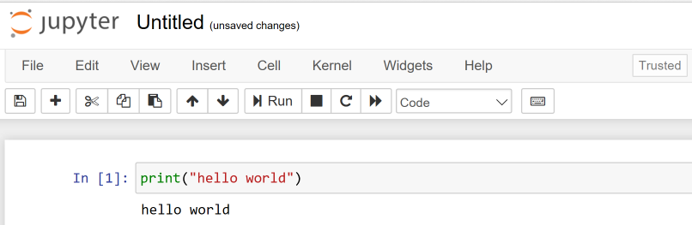
Installing Jupyter Notebook
Play around the jupyter notebook by creating an ipynb file:
https://problemsolvingwithpython.com/02-Jupyter-Notebooks/02.04-Opening-a-Jupyter-Notebook/
https://problemsolvingwithpython.com/02-Jupyter-Notebooks/02.05-The-Jupyter-Notebook-Interface/

Slide 14
Thank You

Slide 15
Other notes
Anaconda should have added its path to the PATH variable in your machine.
If not, add where you installed it to the front of your PATH environment variable.
Windows:
Edit the environment variables and add
path\to\anaconda ,
path\to\anaconda\Library\mingw-w64\bin ,
path\to\anaconda\Library\usr\bin ,
path\to\anaconda\Library\bin ,
path\to\anaconda\Library\Scripts ,
path\to\anaconda\Scripts
into the Path.

Slide 16
Other notes
Anaconda should have added its path to the PATH variable in your machine.
If not, add where you installed it to the front of your PATH environment variable.
Linux / Mac OS:
Edit the ~/.bashrc file and add
export PATH=/path/to/anaconda/bin:PATH
as the last line.

